Slide 1


The Queen’s Nursing Institute: an introduction
Sue Boran MSc RNT RN DN QN
Director of Nursing Programmes

Slide 2
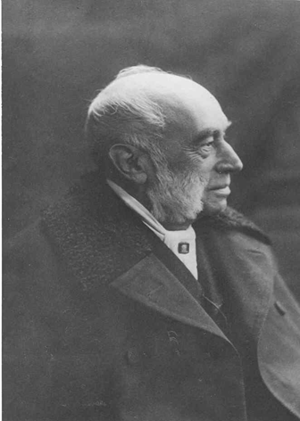

The Queen’s Nursing Institute
Registered Charity founded in 1887
Oldest Nursing Charity in the world
Celebrated 133 years
Works with the public, nurses and decision
makers to influence policy
Ensures good quality community nursing care

Slide 3





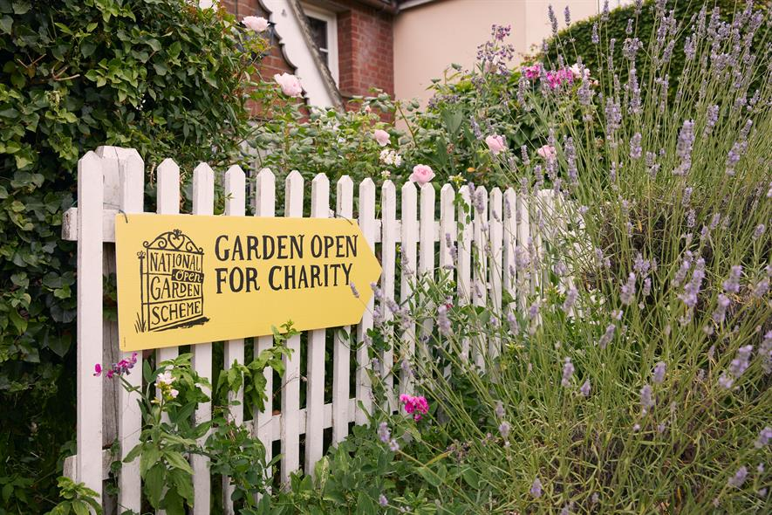


Slide 4

Our vision is that all people are provided with the best possible nursing care by the right nurse, with the right skills in homes and communities, whenever and wherever it is needed.

Slide 5
Our values
Partnership: with people, patients, organisations and policy makers, ensuring individuals, families, carers and communities are at the heart of all we do.
Integrity: living the values and seeing equality and diversity as strengths.
Excellence: in nursing, supported by innovation and evidence.
Independence: using evidence and insight to provide an independent voice.
Advocacy: recognising the contribution of all community nurses.
Legacy: cherishing the history of the QNI and our long-standing relationship with funders.

Slide 6


Our goals
Policy Influence
Data and Evidence
Standards for Education and Practice
Innovation
Role models and leaders
Support for Nurses

Slide 7
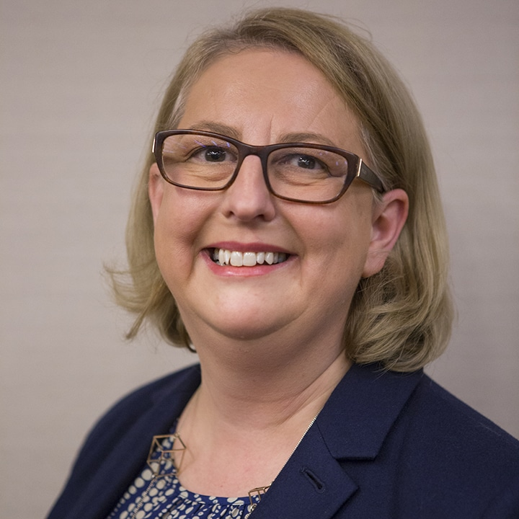
Policy and Influence/Data and Evidence:
International Community Nursing Observatory
Director: Professor Alison Leary MBE QNI Fellow
Launch: November 18th 2019 @Twitter HQ
Publication of Report: District Nursing Today: The view of DN team leaders in the UK
The Experience of Care Home Staff during
Covid-19

Slide 8




Standards for Education and Practice

Slide 9

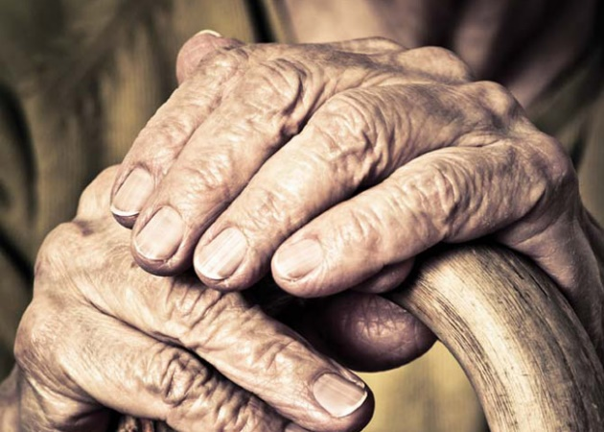
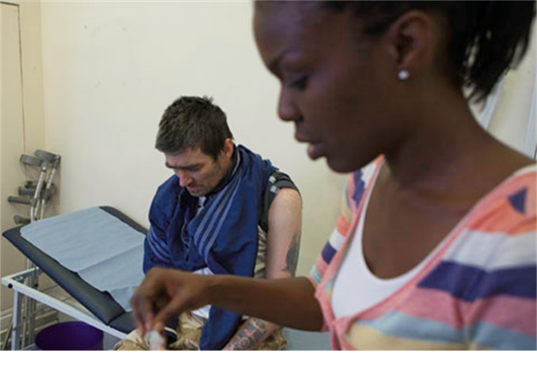


Community Nurse - led Innovation Projects
Men's Health (2017)
Homeless Health (2018)
People living with Frailty (2019)
People with a Learning Disability (2020)
People with Complex Needs in Primary Care (2021)

Slide 10
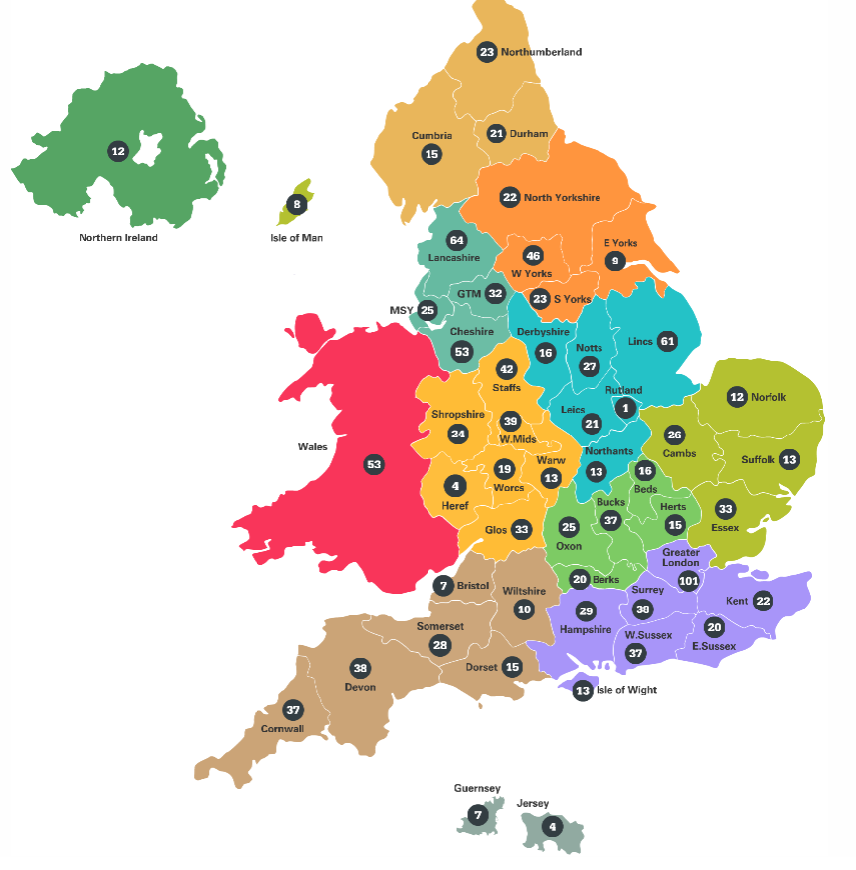

Role models and Leaders:
Queen’s Nurse Title

Slide 11


Support for Nurses
Nurses who receive help from us are mostly going through a time of personal crisis or uncertainty. This may include, but not be restricted to, physical or mental illness, trying to escape domestic abuse, or experiencing other life crises, such as eviction, family health problems, marriage breakdown or bereavement.
As well as grants for nurses in financial difficulty, we also offer educational grants to community nurses who are in financial need.
Joanne Moorby, Grants Manager
Joanne.Moorby@qni.org.uk

Slide 12
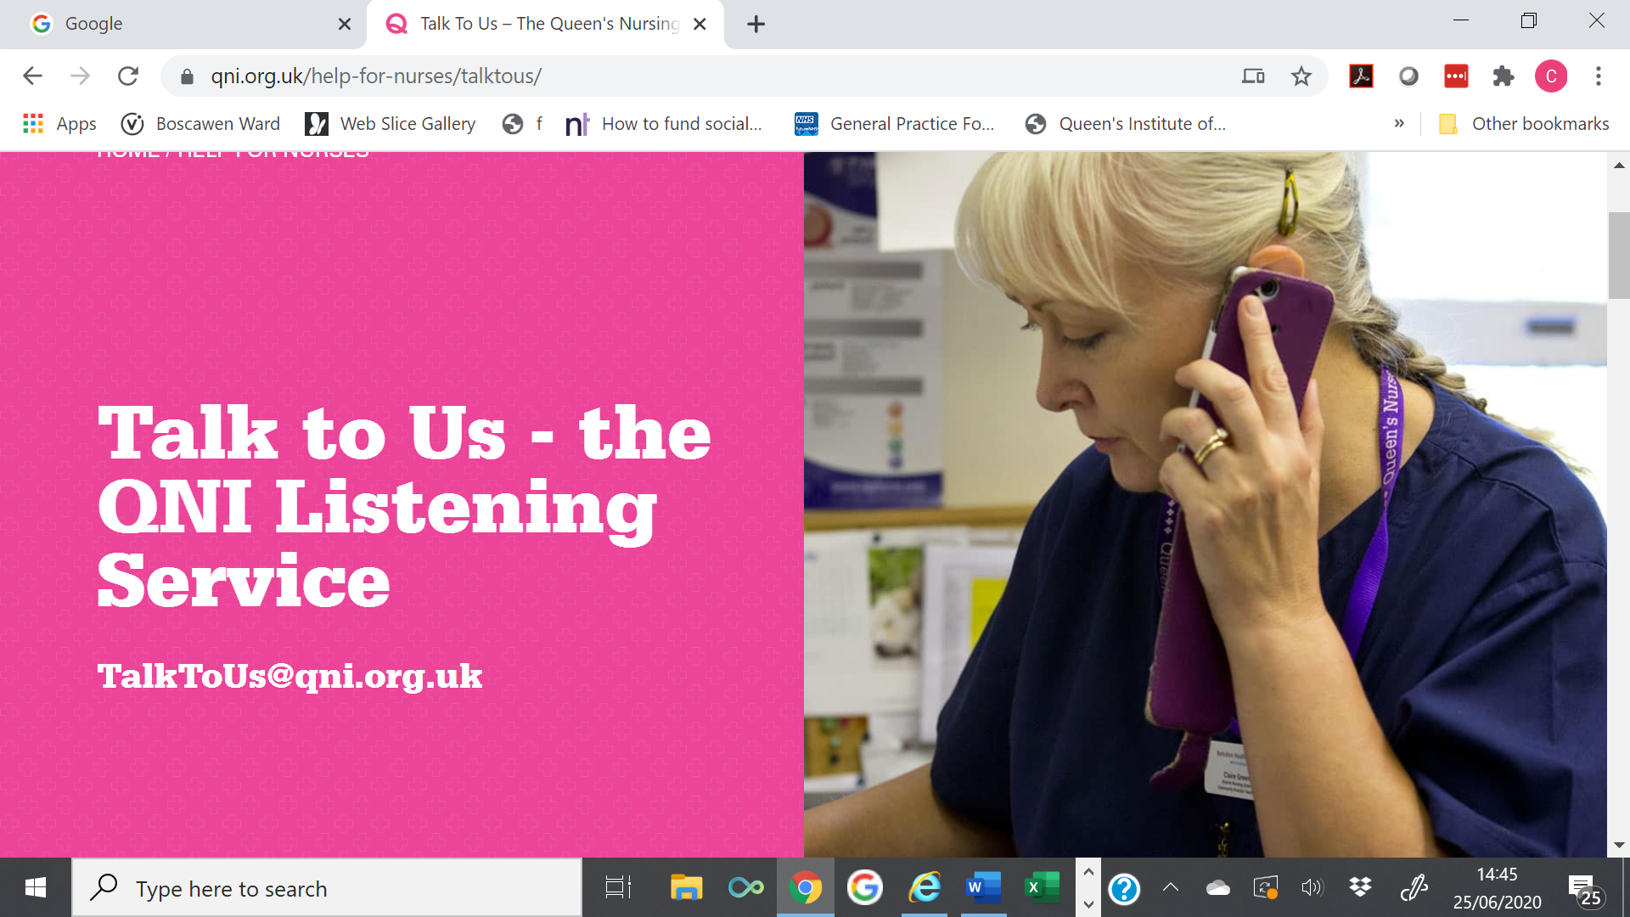
Support for Nurses
Created in response to the pandemic
Trained listeners provide the service
Listen to all community nurses
Please share in your teams

Slide 13
QNI Today
Loss of income down 60% – massive for QNI
National Gardens Scheme – gardens not opening
Investment income plummeted
Annual conference postponed to virtual in October
Project income postponed until September and January
Homeless Health Programme funding ended
Second QN Award application cancelled

Slide 14
QNI Update
Impact on the team
3 posts deleted
2 staff placed on furlough
4 staff reduced hours

Slide 15
Pandemic Activity
Queen’s Nurse Network
Homeless Health Network
Care Home Nurse Network
Community Nursing Executive Network
Policy Influence

Slide 16
Pandemic Activity
QNI Coronavirus Information Centre
HEE Rapid Training Plans:
  Orientation and Induction
  Care Home Nurses, General Practice Nurses, District Nurses
GPN Minimum Bridging Competencies
NHS Professional – Essential Learning Resource for Nurses Transitioning into Care Home Setting
Collection of ‘good practice’ case studies

Slide 17
Future Events/ Plans
QNI Annual Conference
Executive Nurse/ Aspiring Leadership Programmes
Learning Management System
QNI Internal Review of Race and Inclusivity
Post Covid-19 Rehabilitation Resource for Community and Primary Care Nurses

